Slide 1
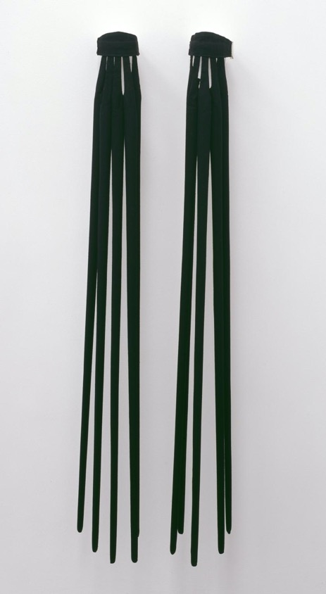
Rebecca Horn
Finger gloves

Slide 2
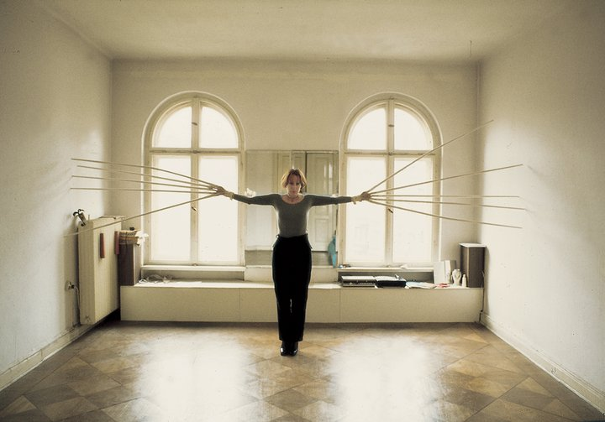
Rebecca Horn, Finger Gloves

Slide 3
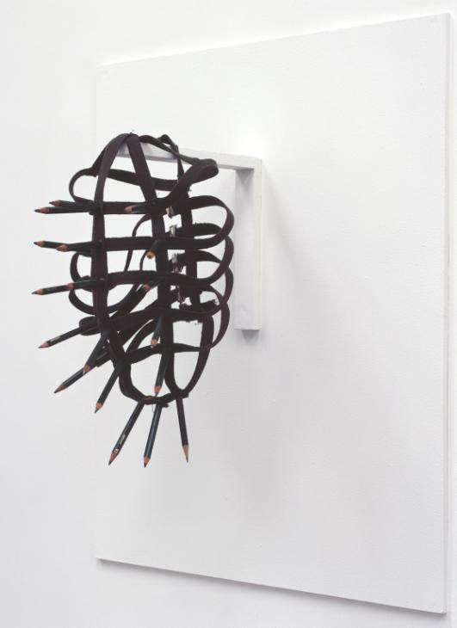
Rebecca Horn
Pencil mask

Slide 4
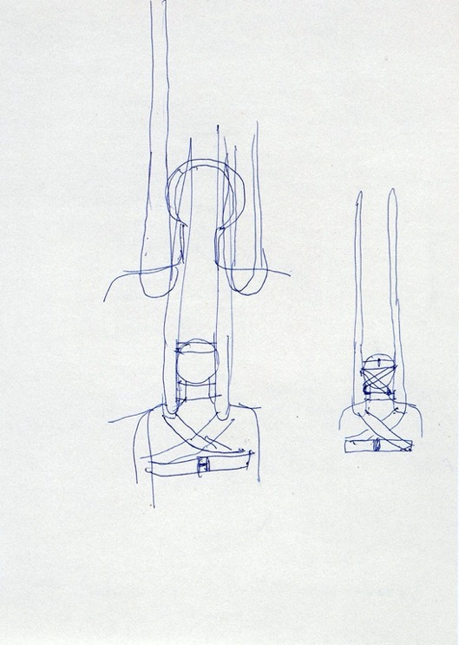
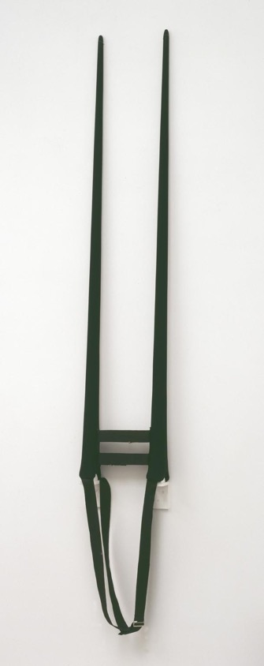
Rebecca Horn
Movable shoulder
extensions

Slide 5
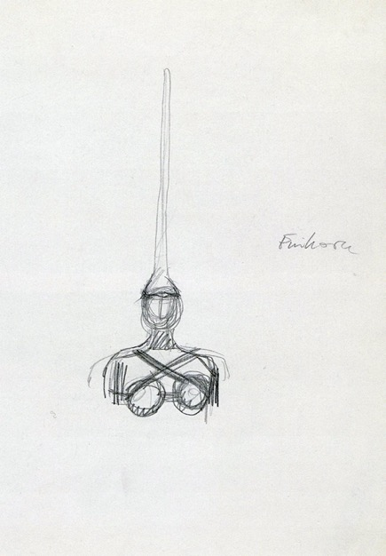
Rebecca Horn
Unicorn

Slide 6
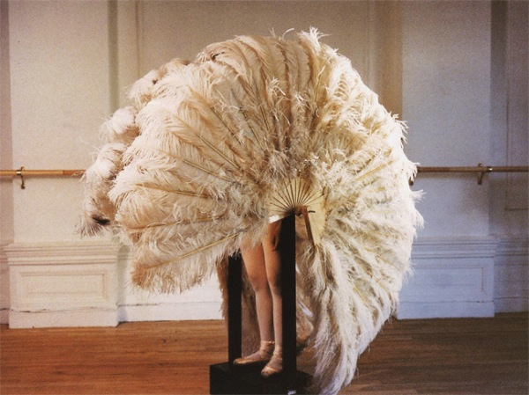
Rebecca Horn
The feathered
prison fan

Slide 7
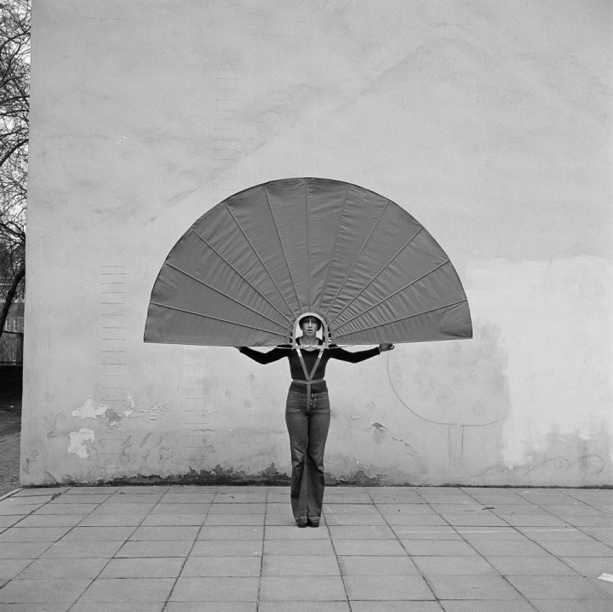
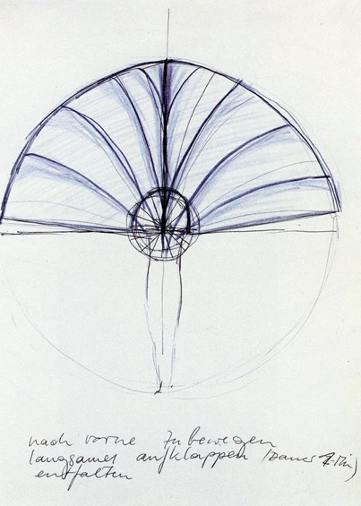
Rebecca Horn
Mechanical body fan

